Slide 1




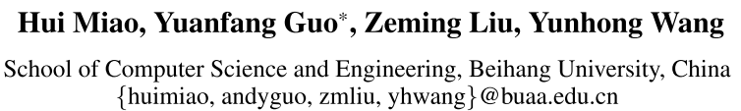





ATAI
Advanced Techniqueof Artificial Intelligence
ATAI
ChongqingUniversity _{AdvancedTechniqueof}
of Technology Artificial Intelligence
Chongqing University of
Technology
Chongqing University ^{ATAI}
_{of Technology} Advanced Techniqueof
Artificial Intelligence
Chongqing University of Technology
Chongqing University of Technology
Multi-modal Deepfake Detection via Multi-task Audio-Visual Prompt Learning
—— AAAI 2025
Code: None
Reported by Tingting Zhang
1

Slide 2

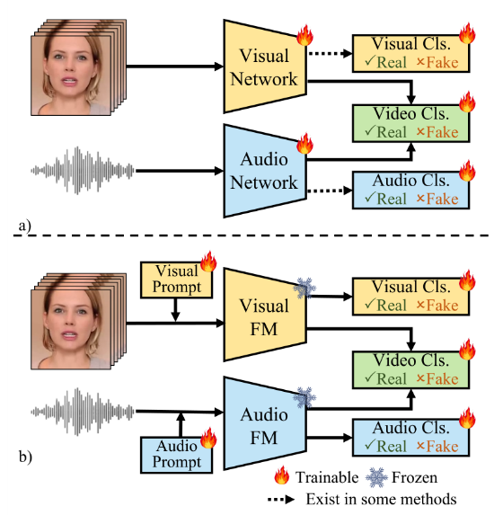
ATAI
AdvancedTechniqueof
Artificial Intelligence
ATAI
ChongqingUniversity _{AdvancedTechniqueof}
of Technology Artificial Intelligence
ChongqingUniversity of Technology
Motivation
ignore the relationships between audio and visual content (tend to consider each modality independently).
giving less satisfactory performance when the audio-visual signals have high consistencies.
only construct the contrastive learning loss at the segment level, which prevents them from learning fine-grained frame-level consistency features.
Notes:
ignored the relationships between audio and visual content.
This mechanism tends to give less satisfactory performance when the audio-visual signals have high consistencies.
If the attackers generate lip-sync deepfake data, the coarse features may not be able to precisely model the slight inconsistencies in the forged videos.

Slide 3

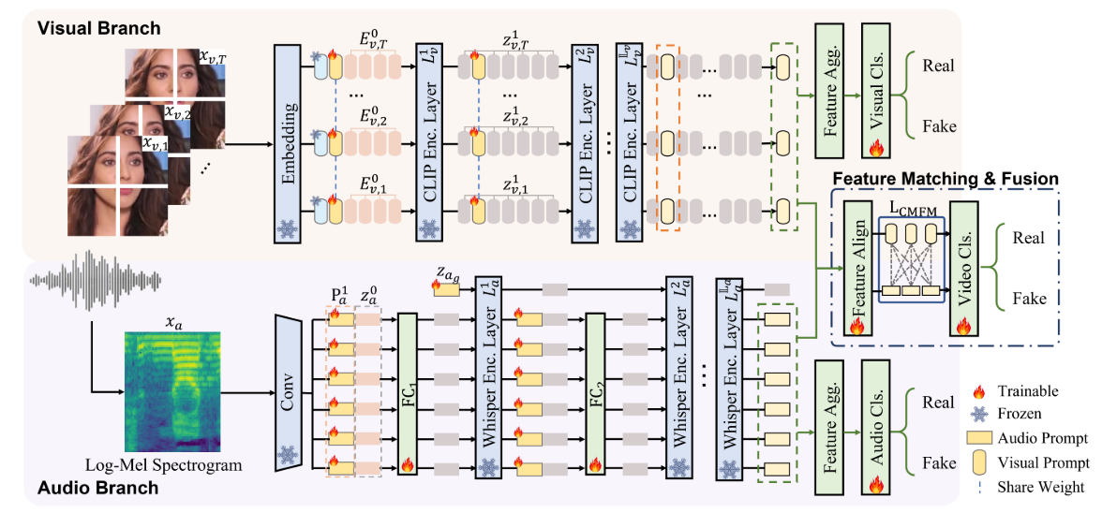
ChongqingUniversity of Technology
ATAI
AdvancedTechniqueof
Artificial Intelligence
ATAI
ChongqingUniversity _{AdvancedTechniqueof}
of Technology Artificial Intelligence
Overview

Slide 4

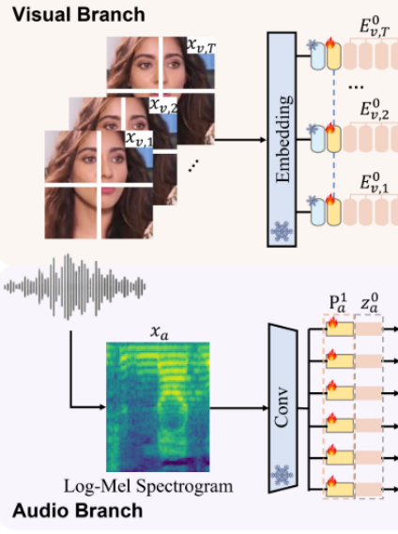
ChongqingUniversity of Technology
ATAI
AdvancedTechniqueof
Artificial Intelligence
ATAI
ChongqingUniversity _{AdvancedTechniqueof}
of Technology Artificial Intelligence
Method
Backgrounds
CLIP
Whisper

Slide 5

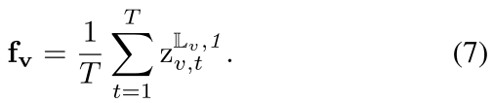
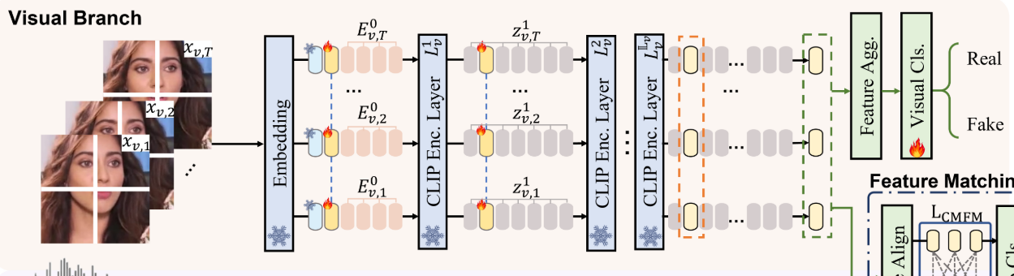
ChongqingUniversity of Technology
ATAI
AdvancedTechniqueof
Artificial Intelligence
ATAI
ChongqingUniversity _{AdvancedTechniqueof}
of Technology Artificial Intelligence
Method
Methodology
Visual Prompt Learning and Classification

Slide 6
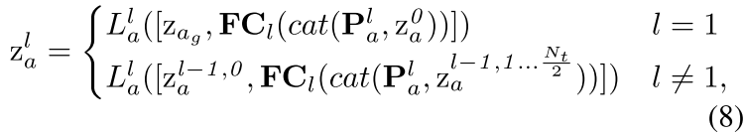
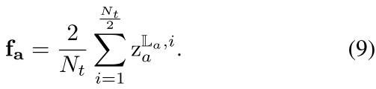
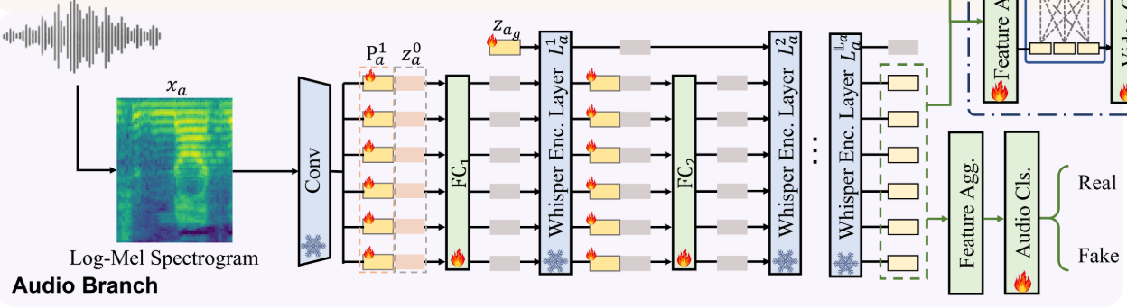
ChongqingUniversity of Technology
ATAI
AdvancedTechniqueof
Artificial Intelligence
ATAI
ChongqingUniversity _{AdvancedTechniqueof}
of Technology Artificial Intelligence
Method
Audio Prompt Learning and Classification

Slide 7
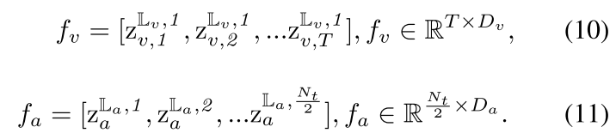
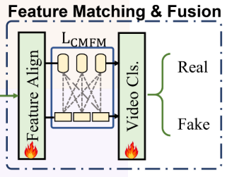
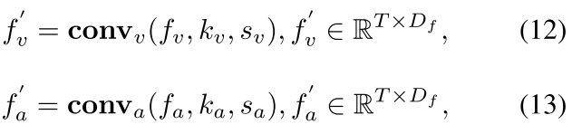
ChongqingUniversity of Technology
ATAI
AdvancedTechniqueof
Artificial Intelligence
ATAI
ChongqingUniversity _{AdvancedTechniqueof}
of Technology Artificial Intelligence
Method
Frame-level Feature Matching and Fusion

Slide 8
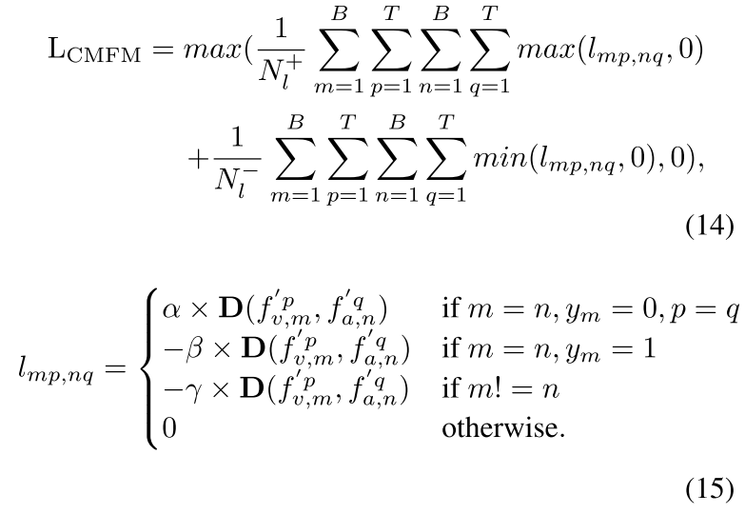
ChongqingUniversity of Technology
ATAI
AdvancedTechniqueof
Artificial Intelligence
ATAI
ChongqingUniversity _{AdvancedTechniqueof}
of Technology Artificial Intelligence
Method
Frame-level Feature Matching and Fusion

Slide 9

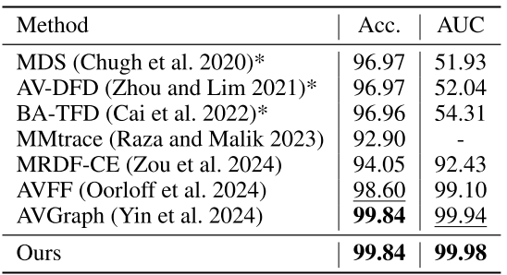
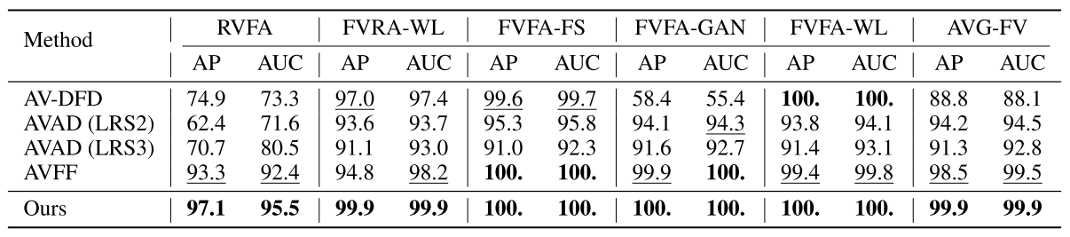
ATAI
AdvancedTechniqueof
Artificial Intelligence
ATAI
ChongqingUniversity _{AdvancedTechniqueof}
of Technology Artificial Intelligence
ChongqingUniversity of Technology
Experiments

Slide 10
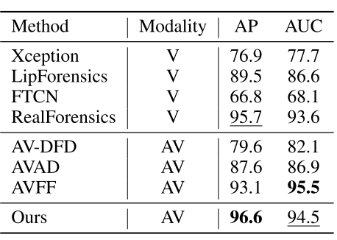
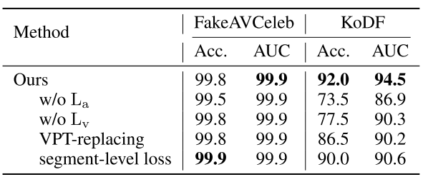
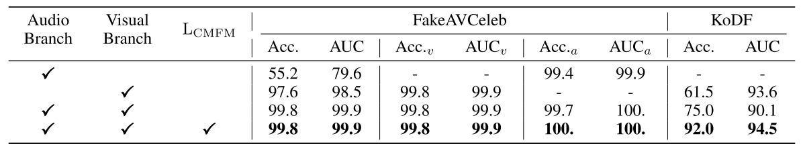
ATAI
AdvancedTechniqueof
Artificial Intelligence
ATAI
ChongqingUniversity _{AdvancedTechniqueof}
of Technology Artificial Intelligence
ChongqingUniversity of Technology
Experiments

Slide 11
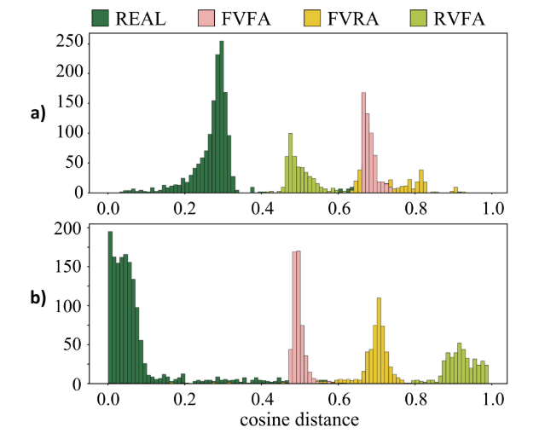
ATAI
AdvancedTechniqueof
Artificial Intelligence
ATAI
ChongqingUniversity _{AdvancedTechniqueof}
of Technology Artificial Intelligence
ChongqingUniversity of Technology
Experiments

Slide 12


ChongqingUniversity of Technology
ATAI
AdvancedTechniqueof
Artificial Intelligence
ATAI
ChongqingUniversity _{AdvancedTechniqueof}
of Technology Artificial Intelligence
Thanks!

